Slide 1

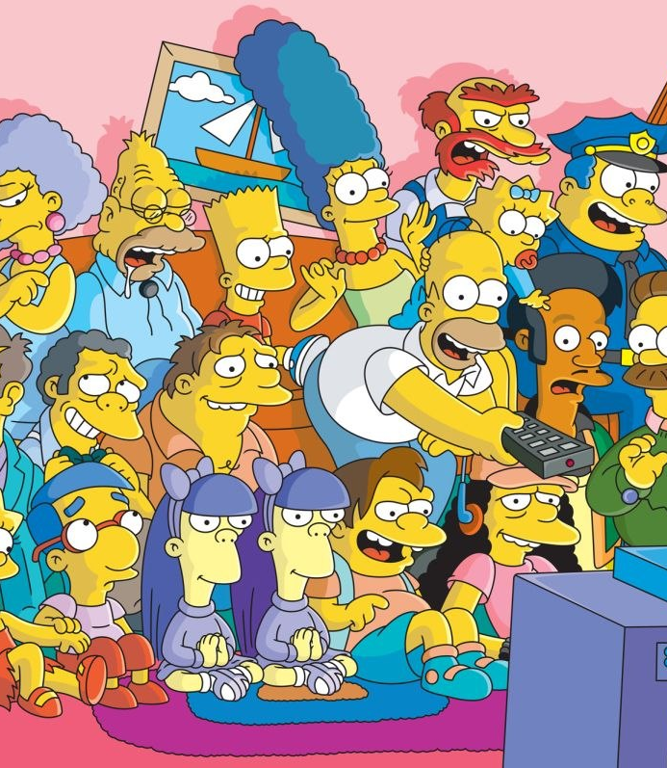
Image Detection of Simpsons Characters
DAEN 690 Project
Summer 2019
Manju Prasad, Ravi Rane, Zegang Liu, Yinchen Niu

Slide 2

Data Sets
Data Sets
Sprint 2 – Week 1 Presentation
11 June 2019

Slide 3
Project Sprints
Sprint
Milestone Goals
Presentation
Problem Definition and Project Plans
Problem (decision) defined
Understanding of complexity
Potential data source identified
Potential analytics identified
Project schedule defined
Participant roles assigned
Risks identified and mitigation plan
Mid-Sprint 28 May; Full Sprint 4 Jun
Data Sets
Data located and accessed
Initial processing underway
Risks identified and mitigated
Mid-sprint 11 Jun;
Full Sprint 18 Jun
Analytics/algorithms
Algorithms defined and coded
Initial applications completed
Risks identified and mitigated
Mid-sprint 25 Jun
& 2 Jul;
Full Sprint 9 Jul
Visualizations
Visualization concepts defined
Visualization implemented
Risks identified and mitigated
Mid-sprint 16 Jul;
Full Sprint 23 Jul
Mid-Sprint 30 July;
Full Sprint 6 Aug
Final Presentations
Project components completed
Project components integrated
Project supports final decision
Presentation made

Slide 4
Sprint Goals
Sprint Goals
Data exploration
Laptop setup
Argo exploration
Understanding of potential algorithms
Risks identified and mitigated

Slide 5
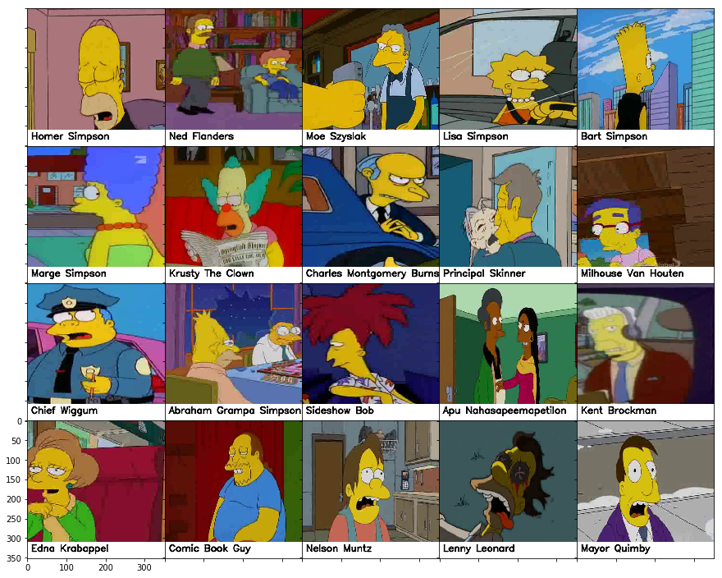
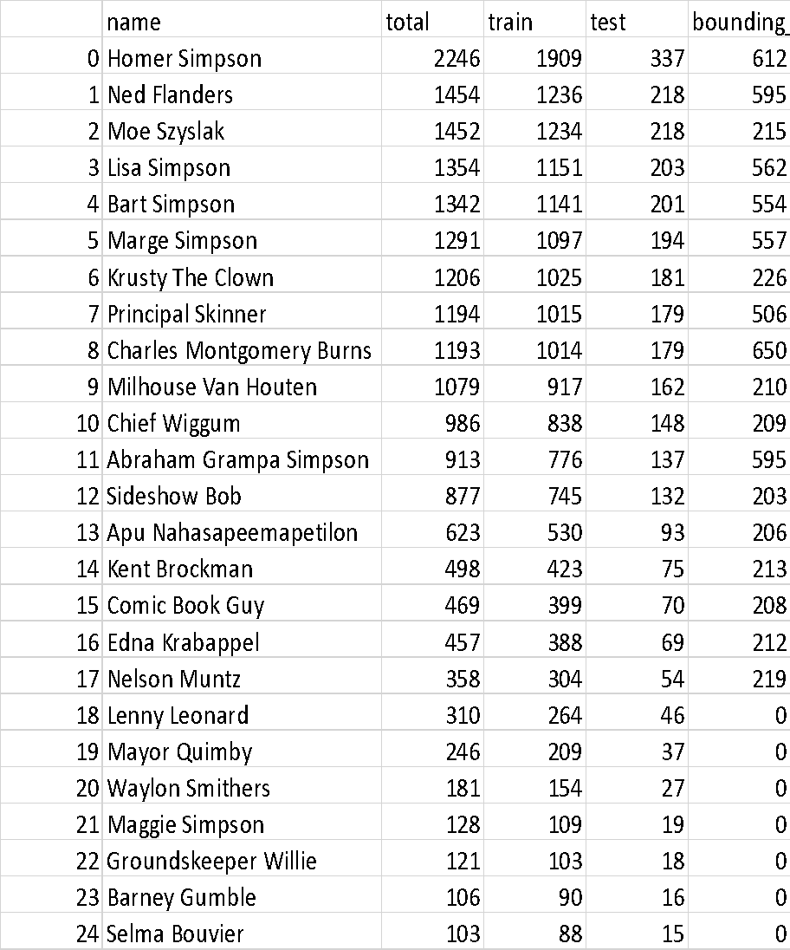
Data Exploration
Table showing all characters with over 100 images in the dataset

Slide 6
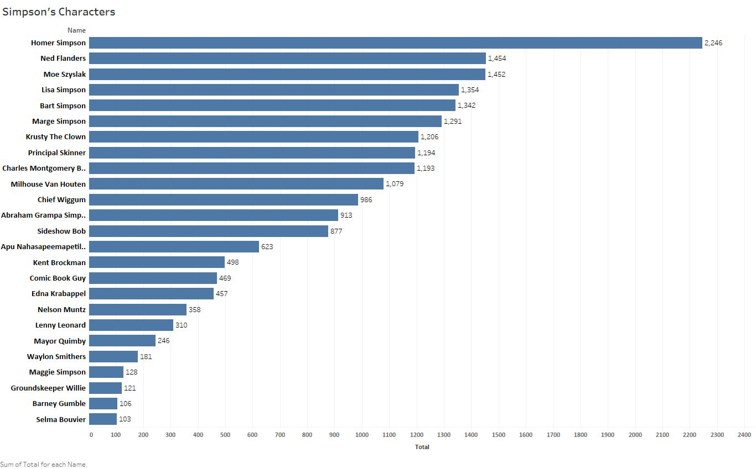
Data Exploration

Slide 7


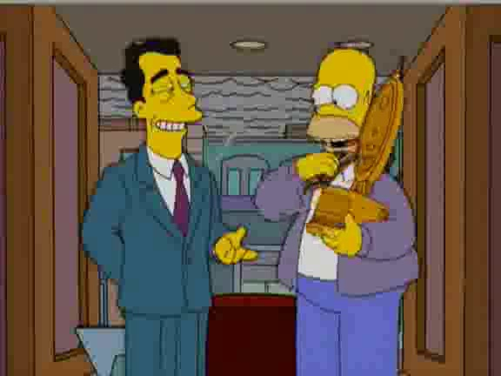

Data Exploration
Example images of Homer Simpson from the dataset. This shows complexity involved in image classification.
Image showing Homer Simpson in different angle (face obscured)
Image with Homer Simpson and multiple other characters
Similar sized characters in an image
Homer Simpson with head wear and body obscured

Slide 8
Data Context
License CC BY-NC-SA 4.0 (Creative Commons License)
(Who)
Agent
Dataset has grown since it was initiated because author has added new images over a period of time.
(What)
Interest in image analytics, deep learning.
(Why)
Data set was downloaded from Kaggle.com
(How)
Cause
Reason
Location
Time
In Kaggle.com
(Where)
Simson’s seasons 4-24
(When)

Slide 9
Laptop Setup
Individual laptop setup includes:
Jupyter notebook or Visual Studio code
Setup Keras, Tensorflow, PyTorch
Python 3.6x
Successfully run sample programs with Keras and PyTorch *
* Some team members working on this

Slide 10
Argo Exploration
Accounts have been setup
Sample .py uploaded, modules initiated
Tutorial on how to use Argo/Swarm planned

Slide 11
Risks Identified and Mitigated
No new risks since identified since Sprint 1

Slide 12
Algorithm Milestone Progress
Laptop setup with necessary applications required to run Deep learning Algorithm.
Repository setup for code base and project directory structure created.
Initial implementation of CNN with 4 convolution layer and one Dense layer.
Successfully ran on laptop for small dataset of Simpson images.
Execution setup for Argo is completed but due to some account related issue, not able to submit job on cluster. Currently checking with Argo support team.
12

Slide 13
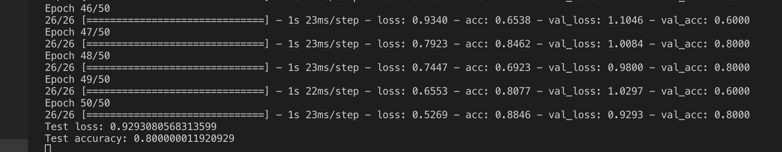
Execution Log

Slide 14
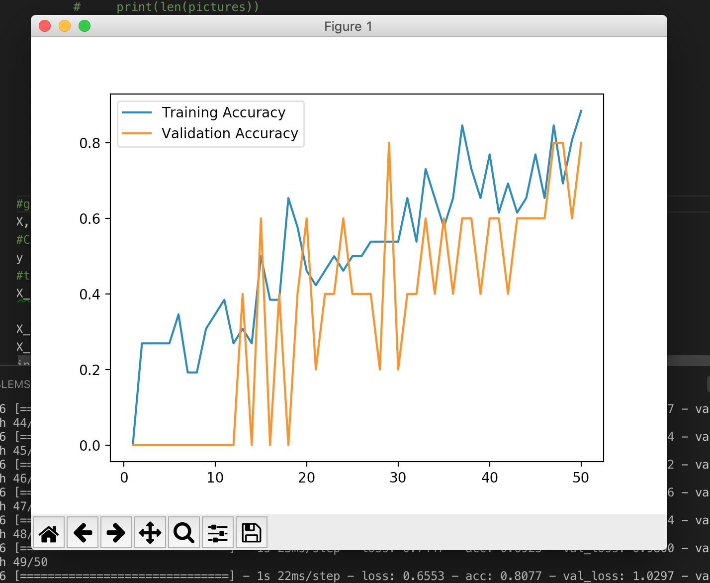
Performance for
Small Dataset

Slide 15
Q&A

